Slide 1
MINI PROJECT
Name | Gayana KO Siddharth AK Suhaas D
Registration Numbers | 251100610004 | 251100610010 | 251100610033
Branch | CSE-5
Project Title | Fraud Detection Using Machine Leaning
Guide | Dr. Keerthana Prasad

Slide 2
CONTENTS
Introduction
Literature Review
Objective
Operational Flow
Functional Requirements
Implementation
Work Done
8. Future work
9. References

Slide 3
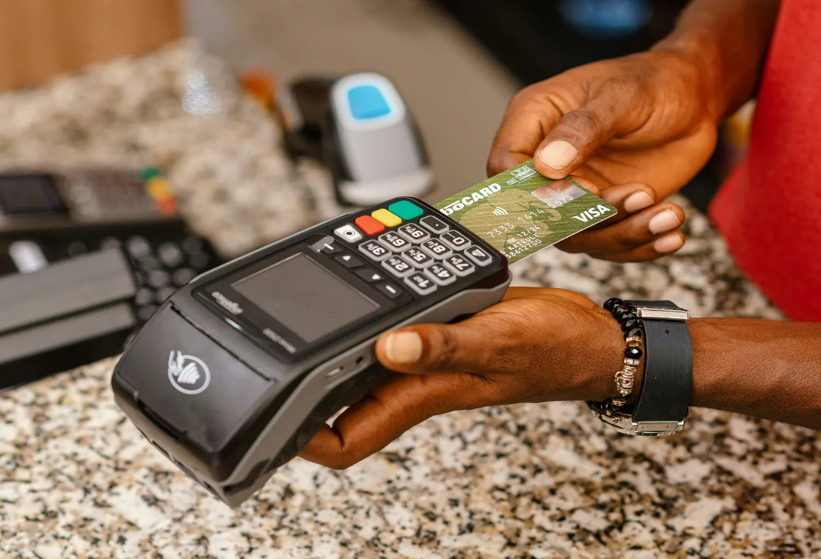
INTRODUCTION
Rapid digitalisation has increased online transactions.
With this growth, financial fraud has become a major concern.
Fraud detection ensures security, trust, and the prevention of financial loss.
Machine Learning helps detect suspicious patterns automatically and efficiently.

Slide 4
LITERATURE REVIEW
Authors and Title | Dataset | Purpose of Study | Key Findings
Aman Negi, Deepak Kumar. "Fraud Detection in Financial Transactions Using Machine Learning Techniques“(1985–2003) | Anonymized financial transaction dataset; public and proprietary sources | Evaluate machine learning models (Random Forest, XGBoost) for financial fraud detection and address data imbalance | XGBoost outperformed others (accuracy: 97.3%, F1-score: 0.95); Feature selection and SMOTE improved results; Ensemble models best for real-time detection
Petr Hajek, Mohammad Zoynul Abedin, Uthayasankar Sivarajah. "Fraud Detection in Mobile Payment Systems using an XGBoost-based Framework“ (2024) | PaySim (simulated mobile transaction data, 6M+ entries | Develop an XGBoost framework for mobile payment fraud detection, addressing class imbalance and financial impact | Semi-supervised XGBoost integrating outlier detection and under-sampling achieved best results and highest cost savings; Outperformed traditional ML methods
P. Nagarajan, Kamali B. "Fraud Detection in Online Transaction using Hybrid CNN and XGBOOST“ (2025) | Kaggle credit card fraud dataset (24,000 transactions, 30 features) | Compare Hybrid CNN-SVM and XGBoost for online transaction fraud detection | Hybrid CNN-SVM outperformed XGBoost in reliability, F1-score, AUC; Effective feature extraction with CNN; Model suitable for imbalanced data
Hongwei Chen, Lun Chen. "An application of XGBoost algorithm for online transaction fraud detection based on improved sailfish optimizer“ (2025) | Kaggle credit card fraud dataset | Improve XGBoost using Improved Sailfish Optimizer (ISFO) for hyperparameter tuning in online fraud detection | SFO-XGBoost achieved top accuracy and metrics, beating other models; SMOTE improved results.

Slide 5
OBJECTIVE
Build an efficient fraud detection model using supervised ML algorithms.
Identify fraudulent transactions based on transaction features.
Achieve high accuracy and minimise false positives.
Analyse model performance using standard metrics (Accuracy, Precision, Recall, F1-score).

Slide 6
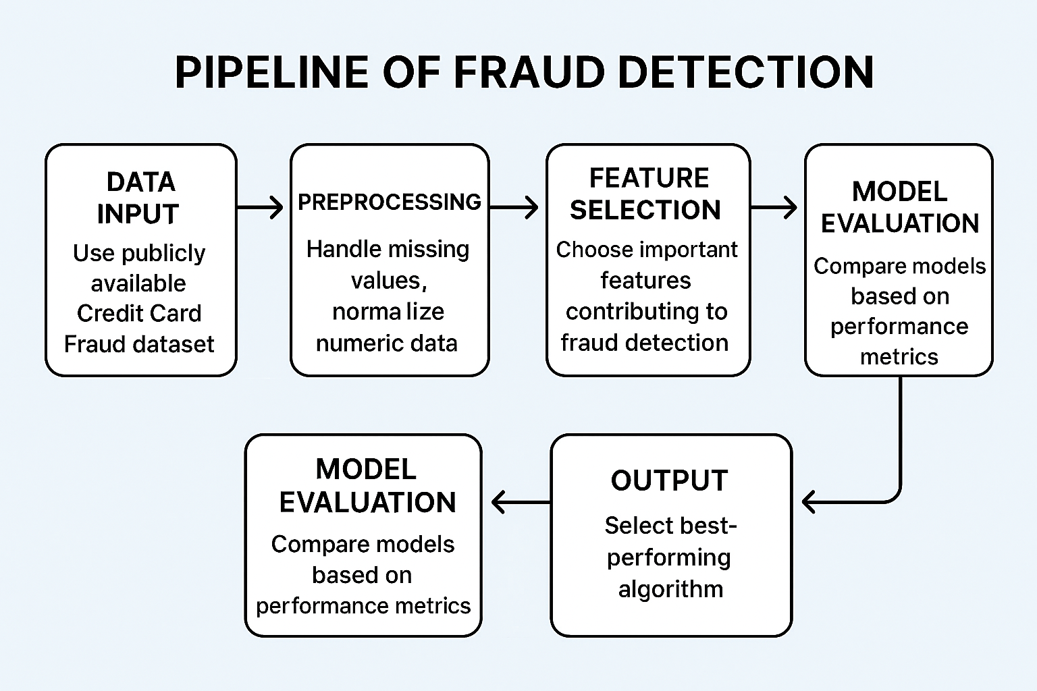
OPERATIONAL FLOW
Flow Steps:
Data Collection: Use publicly available Credit Card Fraud dataset.
Data Preprocessing: Handle missing values, normalise numeric data.
Feature Selection: Choose important features contributing to fraud detection.
Model Training: Apply algorithms like Logistic Regression, Decision Tree, and Random Forest.
Model Evaluation: Compare models based on performance metrics.
Result Analysis: Select the best-performing algorithm.

Slide 7
FUNCTIONAL REQUIREMENTS
Category | Description
Input | Transaction dataset .
Processing | Data cleaning, feature selection, model training
Output | Prediction – Fraudulent or Legitimate transaction
Performance | High accuracy and low error rate
Software Used | Python, NumPy, Pandas, Scikit-learn, Matplotlib
Hardware Used | Standard PC/Laptop with Python environment

Slide 8
DATASETS
Fraud_Data.csv - The main file containing transaction and user details.
Rows : 151,112
Columns : 11
Features:
User Info: user_id, sex, age
Session Info: device_id, source (e.g., SEO, Ads), browser (e.g., Chrome, Safari)
Time Info: signup_time, purchase_time
Transaction Info: purchase_value
Linking Key: ip_address
Target Variable: class

Slide 9
IpAddress_to_Country.csv – IP Address lookup table for the main dataset
Rows : 138,846
Columns : 3
Features:
lower_bound_ip_address: The starting IP address of a geographical block.
upper_bound_ip_address: The ending IP address of that same geographical block.
country: The country associated with all IPs within that specific range.

Slide 10
Final_Data.csv - The master dataset created by merging fraud_data.csv and ipAddress_to_country.csv lookup table.
Rows : 129,146
Columns : 14
Features:
User Account: user_id, device_id
Temporal: signup_time, purchase_time
Transaction: purchase_value, source, browser
Demographics: sex, age
Network: ip_address, lower_bound_ipaddress, upperbound_ipaddress, country
Target: class

Slide 11
ACCURACY PARADOX
Imbalanced dataset
Fraud – 9.5%
Valid = 90.5%
Dummy Classifier – A simple model that follows pre-defined rules.
Accuracy – 90.5%
Better metrics to look at instead – Precision and Recall

Slide 12
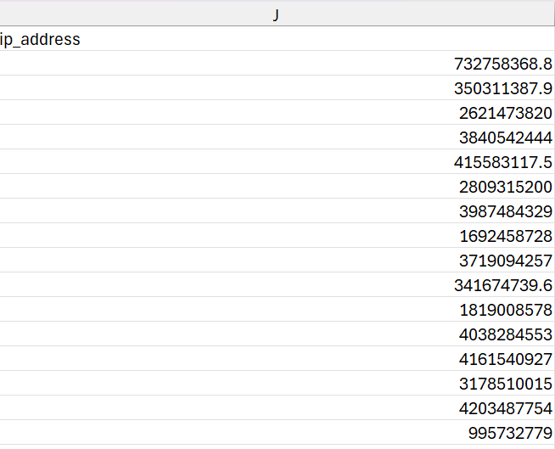
FEATURE ENGINEERING
Geographical Mapping – Mapping IP Address to a country
IP Address column from the main transactional dataset

Slide 13
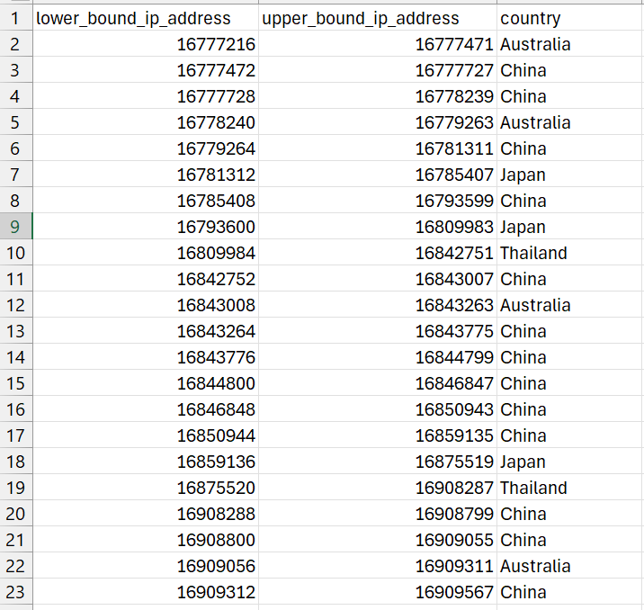
FEATURE ENGINEERING
Lower Bound, Upper bound IP address, and country columns in IP lookup table

Slide 14
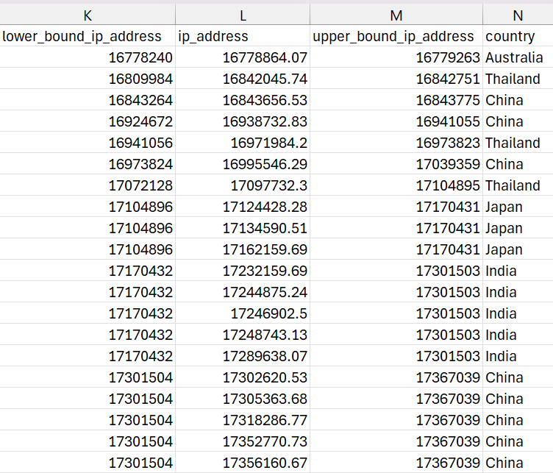
FEATURE ENGINEERING
pandas.merge_asof
Lower_bound_ipaddress<= IP_Address <=Upper_bound_ipaddress
Combined dataset with geographical mapping

Slide 15
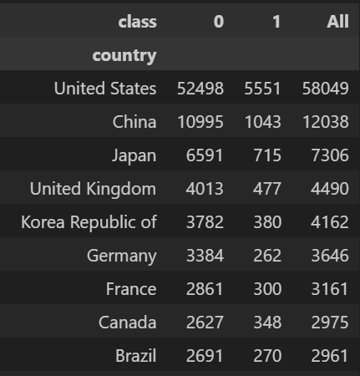
Country | Fraud Rate
United States | 9.56%
China | 8.66%
Japan | 9.78%
United Kingdom | 10.62%
Korea | 9.13%
Country wise fraud patterns

Slide 16
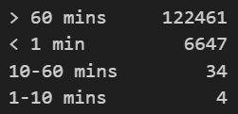
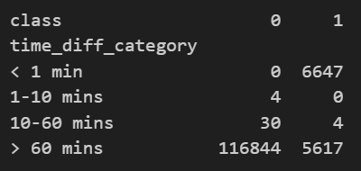
FEATURE ENGINEERING
Temporal features
Time Difference = Purchase Time – Sign Up Time
Automated Bot Activity – Fraudulent transactions often occur significantly faster than legitimate ones.
User Behavioural Timing Analysis
Distribution of Fraud in User Behavioral Timing Analysis

Slide 17
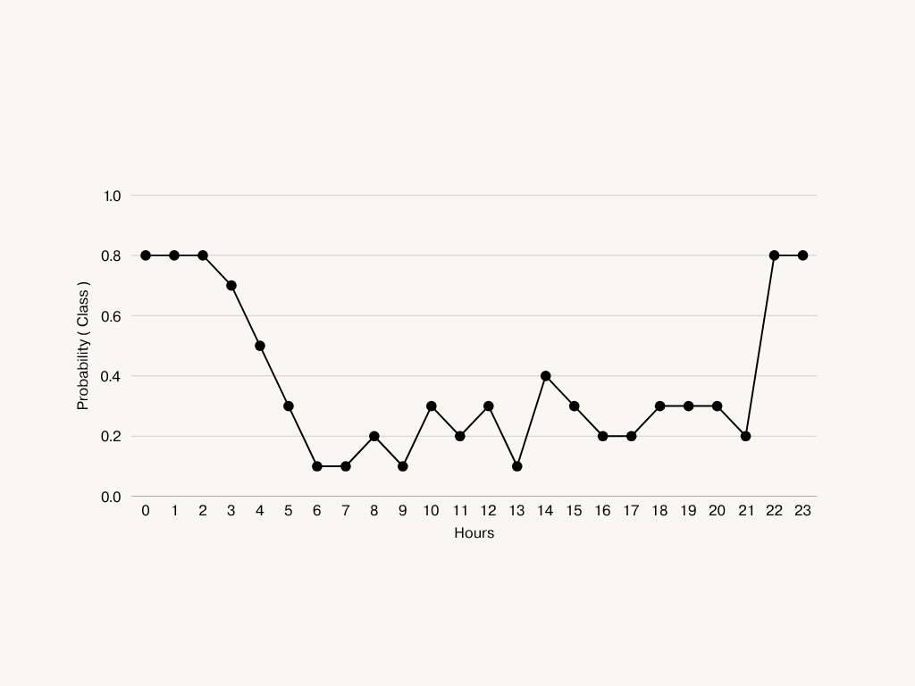
Hourly Fraud Probability Distribution – Linear Time Representation

Slide 18
Hour <= 12
Yes
No
Hour <= 2
Hour < 22
Yes
No
Yes
No
12am – 2am
( 0 – 2)
2:01am – 11:59am
12pm – 9:59 pm
(12-21)
10pm – 11:59pm (22-23:59)
Most likely
fraud
Low fraud
risk
Low fraud
risk
Most likely
fraud
Decision Tree Behavior with Linear Time Representation

Slide 19
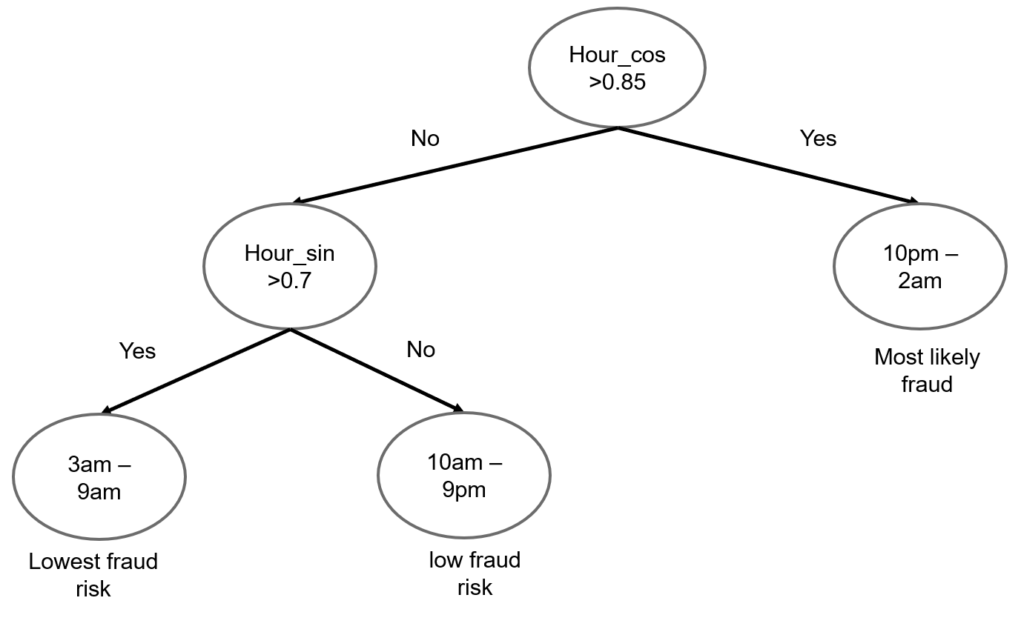
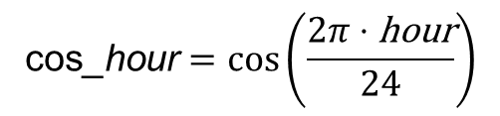
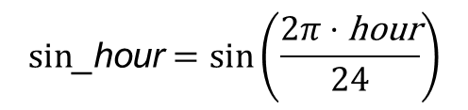
$$\text{cos}\text{_}\text{hour}=\cos\left(\frac{2π⋅\text{hour}}{24}\right)$$
$$\text{s}\text{in}\text{_}\text{hour}=\sin\left(\frac{2π⋅\text{hour}}{24}\right)$$
Hour | Time | Hour_sin | Hour_cos
22 | 10 PM | -0.500 | 0.866
23 | 11 PM | -0.259 | 0.966
0 | 12 AM | 0.000 | 1.000
1 | 1 AM | 0.259 | 0.966
2 | 2 AM | 0.500 | 0.866
Decision Tree Behavior with Cyclic encoding of Time

Slide 20
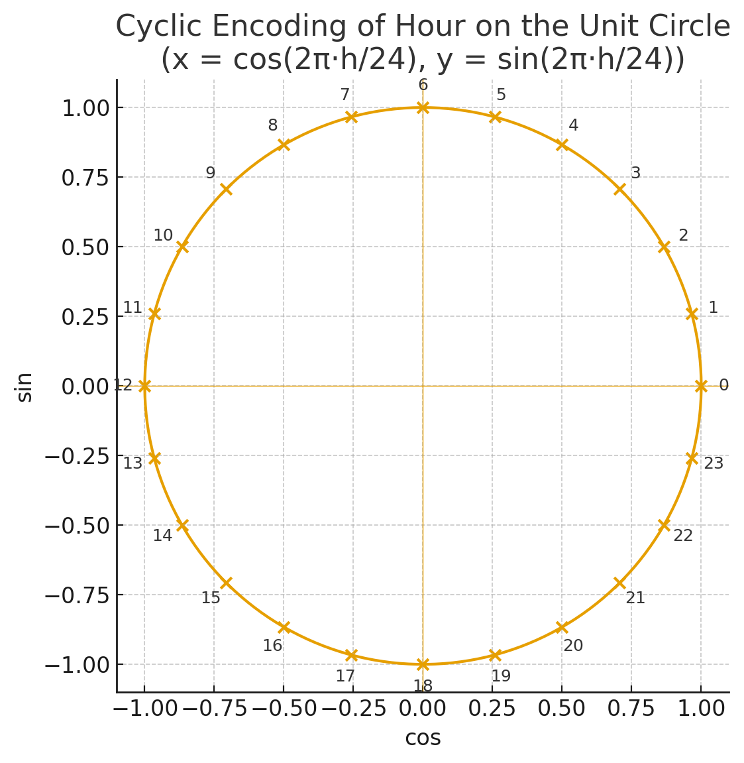
IMPLEMENTATION
Cyclic representation of time

Slide 21
SMOTE - Synthetic Minority Oversampling Technique
It does not duplicate the existing rows.
Creates new synthetic samples by interpolating between real minority samples.
Uses the concept of K-Nearest Neighbour.
Synthetic_sample = Original + λ × (Neighbor - Original)
original = original minority class sample
neighbor = randomly selected neighbor from k-nearest neighbors
λ = random number between 0 and 1
Synthetic sample = new synthetic sample created

Slide 22
SMOTE Parameters
Formula - Synthetic_sample = Original + λ × (Neighbor - Original)
Take first sample (22, 180) as the original sample and second sample (24, 200) as the neighbor.
take λ as 0.5 ( it can be random value between 0 and 1)
age_synthetic = 22 + 0.5 × (24 - 22)
= 23
purchase_value_synthetic = 180 + 0.5 × (200 - 180)
= 190
New synthetic values :
AGE | PURCHASE VALUE
22 | 180
24 | 200
AGE | PURCHASE VALUE
23 | 190

Slide 23
New synthetic point
(23, 190)
(24, 200)
(22, 180)
Visual Demonstration of SMOTE Interpolation

Slide 24
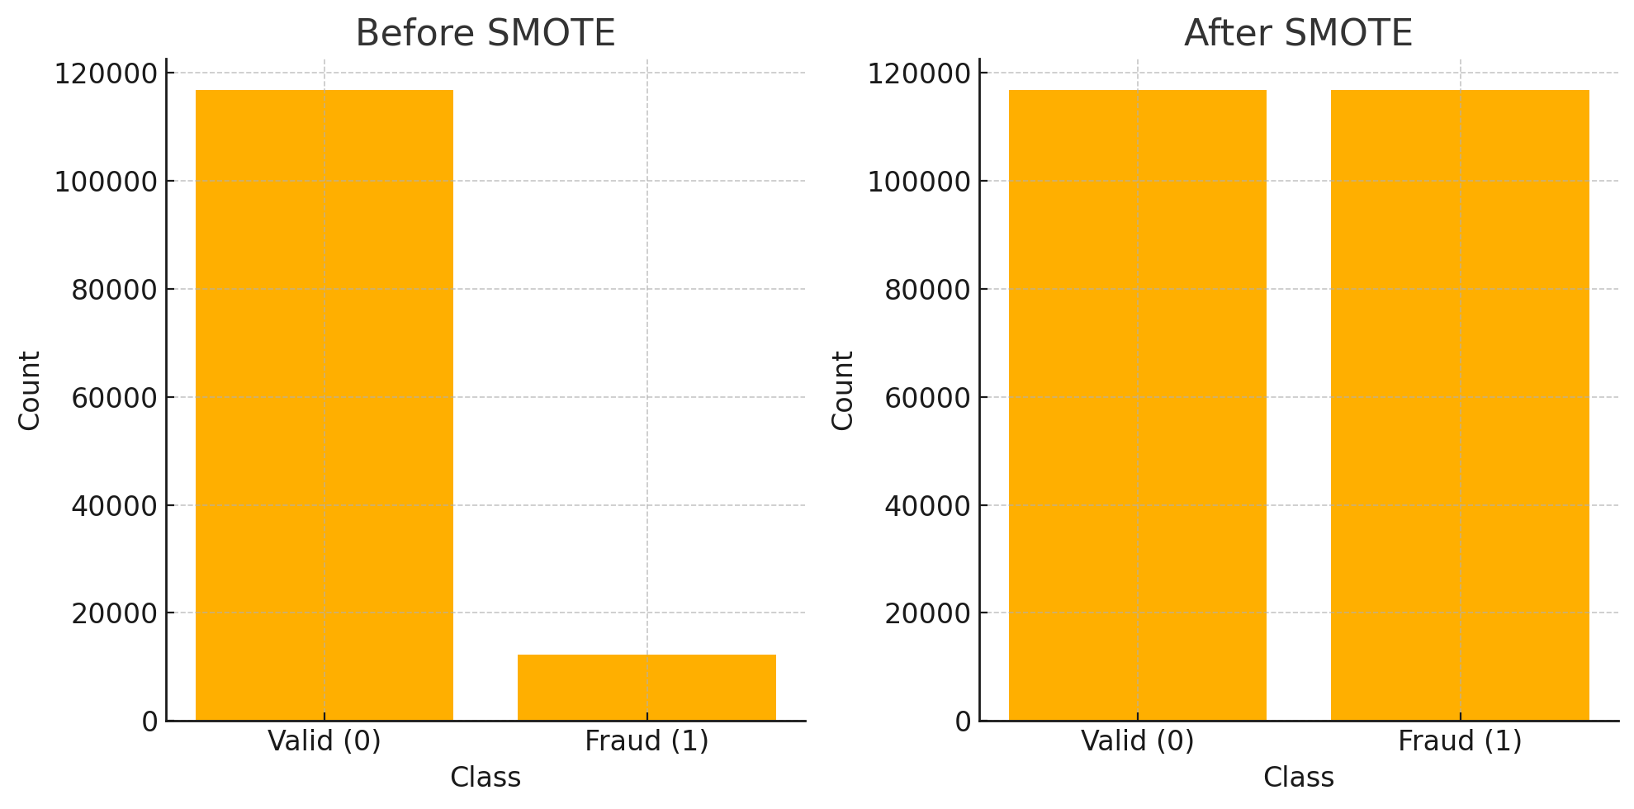
Fraud vs Valid transactions before and after SMOTE

Slide 25
Data Leakage: Why SMOTE Timing Matters
Example DATA : [ A , B , C , D , E ]
SMOTE creates S1 sample using A and B (APPLIED ON THE ENTIRE DATASET)
NEW DATA : [ A , B , C , D , E , S1]
RANDOM TRAIN TEST SPLIT ( 80% Train – 20% Split)
TRAIN
A
D
E
S1
TEST
C
B
S1 Created using B

Slide 26
Correct SMOTE Workflow (Leakage-Free Approach)
Example DATA : [ A , B , C , D , E ]
RANDOM TRAIN TEST SPLIT ( 80% Train – 20% Split)
SMOTE ONLY ON UNCHANGED ( ORIGINAL DATA )
TRAINING DATA
S1 CREATED ONLY USING A, D, E
STAYS WITHIN THE
TRAINING DATASET
TRAIN
A
D
E
TEST
C
B
TRAIN
A
D
E
S1
TEST
C
B

Slide 27
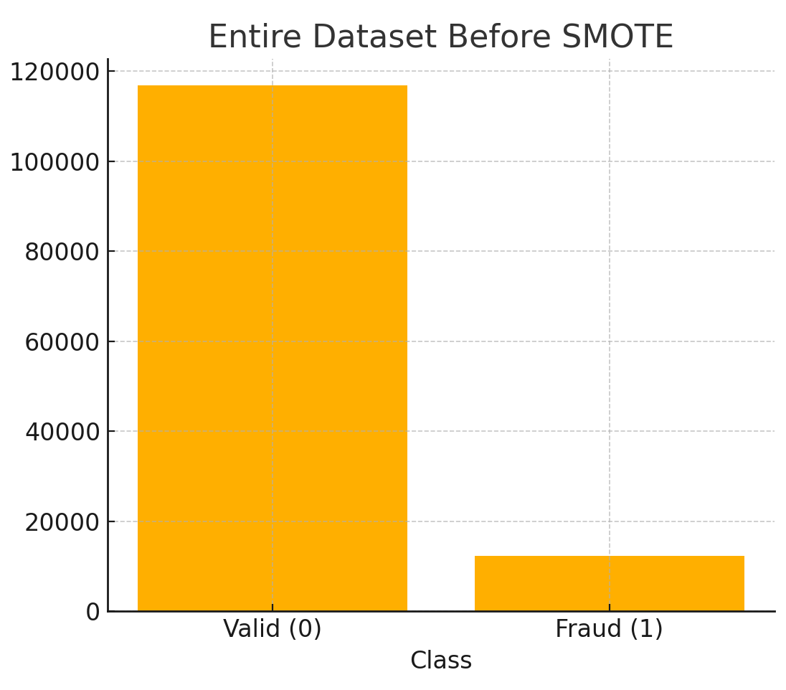
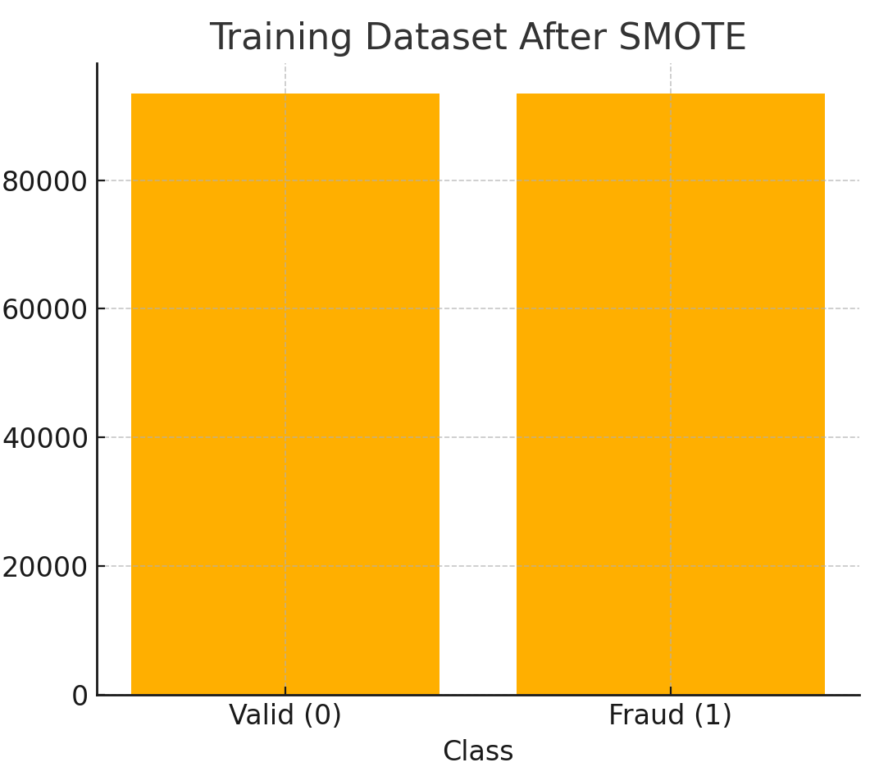

116,878
12,268
93,502
93,502
23,376
2,454
80% of the entire dataset
Fraud (minority) class up sampled
20% of the entire dataset
unchanged

Slide 28
Alternative to SMOTE - scale_pos_weight
scale_pos_weight = Number of valid samples / Number of fraud samples
= 93,520 / 9,798​
= 9.5
A fraud error (False Negative) is treated 9.5x more important than a normal error (False Positive)
Example
Without scale_pos_weight
Misses Fraud A – Error Penalty = 1 (Model assumes it just made ‘1’ small mistake)
With scale_pos_weight
Misses Fraud A – Error Penalty = 1 x 9.5 = 9.5 (Model realizes the mistake is huge and urgently corrects it)

Slide 29
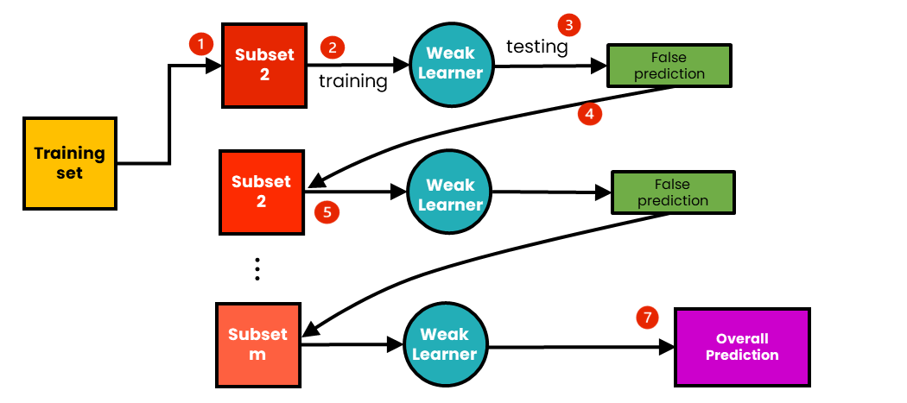
Final Model – XGBoost (Extreme Gradient Boosting)
Dataset
Dataset+error correction
Dataset+error correction
Weak Learner = Decision Tree
Boosting Algorithm - XGBoost

Slide 30
Hyperparameter tuning
Hyperparameters are settings that control how the model learns.
Example Different Combinations of Hyperparameters
Learning rate=0.01
Model learns slowly
May need many trees (800+)
May underfit
Training time – Too Long
Learning rate=0.5
Model learns too quickly
May need many trees (50-60)
May overfit
Training time – too short
Learning rate=0.1
Balanced learning speed
Moderate trees (100-200)
Good fit
Training time – Reasonable

Slide 31
Randomized Search Cross Validation
learning_rate: [0.01, 0.03, 0.05, 0.1, 0.15, 0.2] (6 options)
n_estimators: [100, 200, 300, 500, 700, 800] (6 options)
subsample: [0.6, 0.7, 0.8, 0.9, 1.0] (5 options)
colsample_bytree: [0.6, 0.7, 0.8, 0.9, 1.0] (5 options)
Total possible combinations: 6 × 6 × 5 × 5 = 900 model fits
Testing 900 model fits manually is time consuming
Notes:
N_estimators – number of trees
Subsample - % of training data used per tree
Colsample_bytree - % of features used per tree

Slide 32
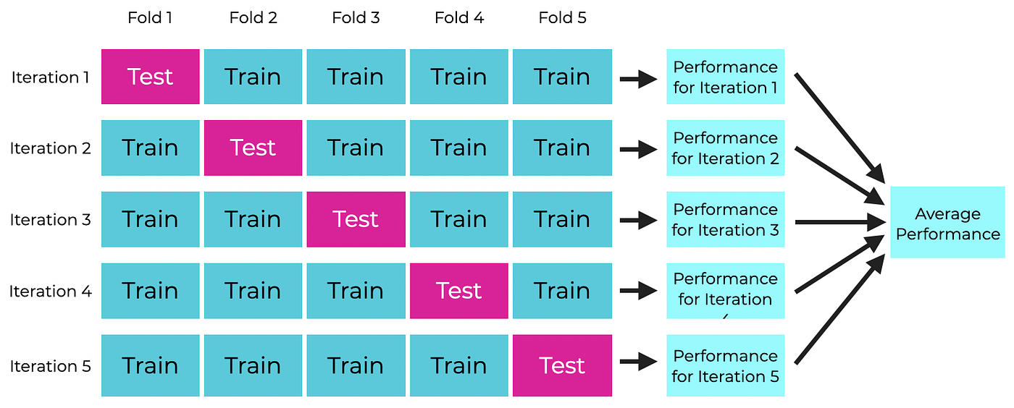
Randomized Search Cross Validation
K-FOLD CROSS VALIDATION
Notes:
N_estimators – number of trees
Subsample - % of training data used per tree
Colsample_bytree - % of features used per tree

Slide 33
Randomized Search Cross Validation
n_iter= 25 ( picks 25 random hyperparameter combinations).
For each combination, run 5-fold stratified cross validation.
Take the average score of the 5 validations, save the score and discard the model.
Repeat the same procedure for 24 other hyperparameter combinations.
25 trials x 5 folds = 125 model fits < 900 models fits we had calculated earlier
Best performing parameters are selected (based on average validation score).
Apply it on the entire training dataset and evaluate with the untouched test set.

Slide 34
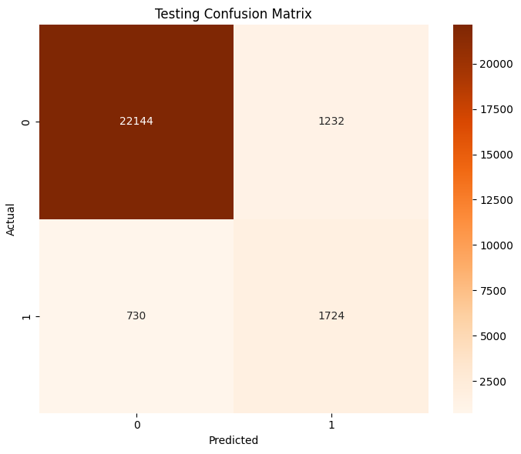
Results and Evaluation metrics
True Positive – 1724
(Actual – Fraud, Predicted – Fraud)
True Negative – 22144
(Actual – Valid, Predicted – Valid)
False Positive – 1232
(Actual – Valid, Predicted – Fraud)
False Negative – 730
(Actual – Fraud, Predicted – Valid)

Slide 35
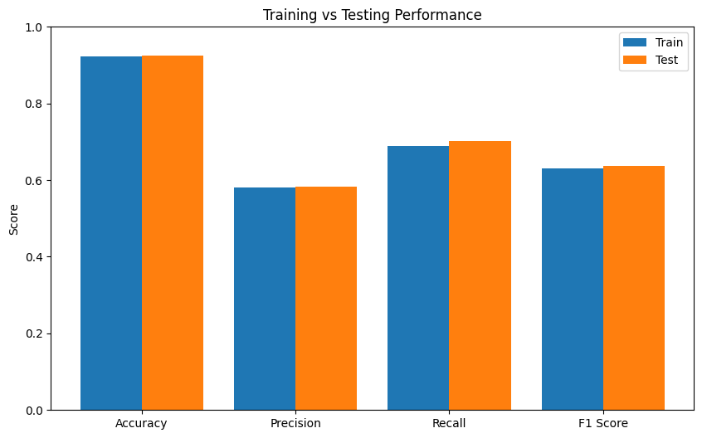
Results and Evaluation metrics

Slide 36
Threshold Tuning — A Business-Driven Decision
Example
Error type | Business Impact
Missing a fraud ( False Negative) | ₹40,000 average loss
Investigating a valid transaction (False Positive) | ₹4,000 investigation cost
Cost Ratio = 40,000 : 4,000 = 10 : 1
Missing a fraud is 10 times more expensive than checking a valid transaction.
Therefore, Businesses prefer HIGHER RECALL.

Slide 37
Threshold Tuning — A Business-Driven Decision
Very Low thresholds ( 0.1 – 0.3) | Mid-Range Thresholds (0.35 – 0.6) | Very High Thresholds (0.65 – 0.95)
Marked everything as fraud Accuracy – 10 % | Model catches most of the fraud. Accuracy – 84 – 93% | Missed almost every fraud
Mid-Range thresholds maximize business value.

Slide 38
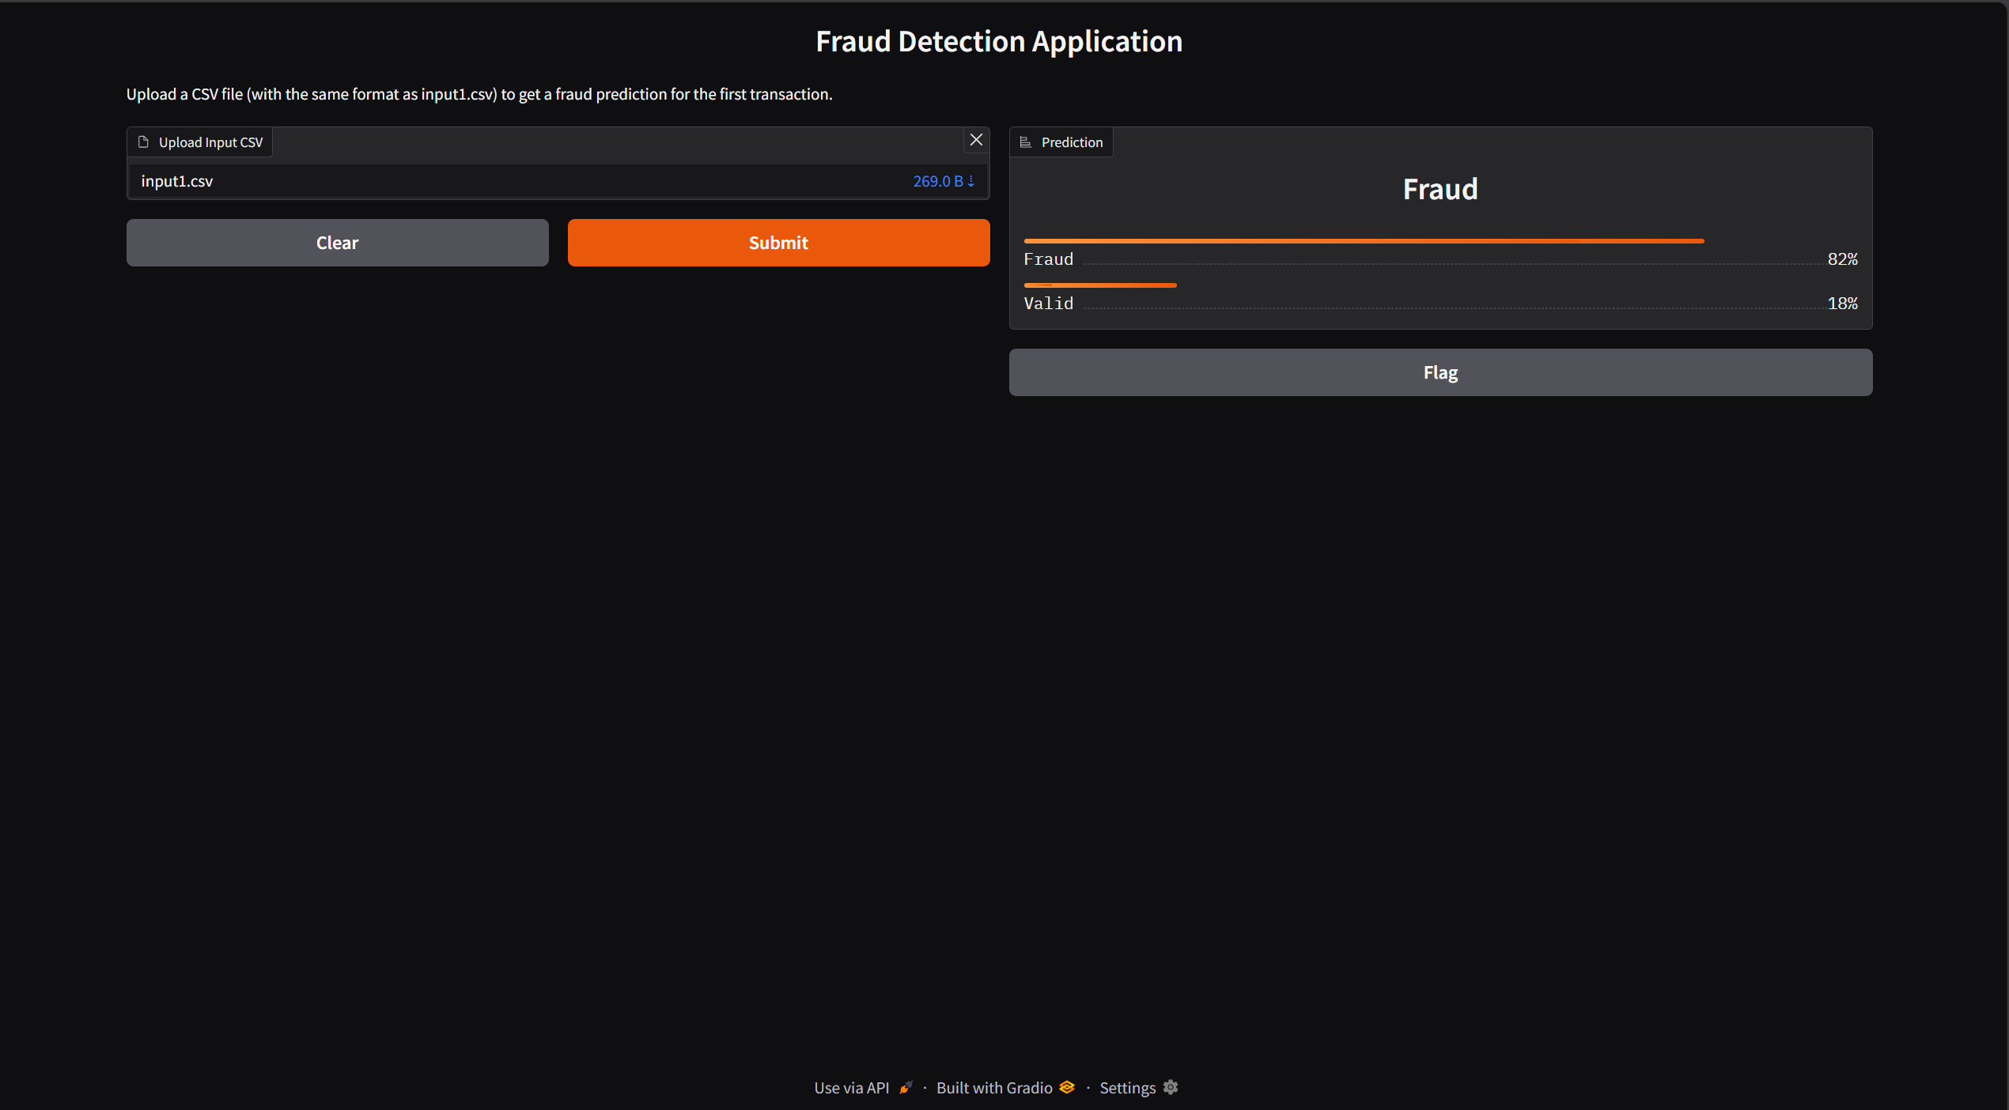
User Interface Demonstration

Slide 39
Project Repository & Documentation
GitHub Repo – Complete project code
🔗 github/SUHAAS_D
GitHub Project Commits – Full Commit History
🔗 github/SUHAAS_D/fraud_detection_commits

Slide 40
REFERENCES
[1]. Hajek, P., Abedin, M.Z., & Sivarajah, U. (2023). Fraud Detection in Mobile Payment Systems using an XGBoost-based Framework. Information Systems Frontiers, 25, 1985–2003.
[2].Nagarajan, P., & Kamali, B. (2024). Fraud Detection in Online Transactions using Hybrid CNN and XGBOOST. Proceedings of the 2024 International Conference on Emerging Research in Computational Science.
[3].Negi, A., & Kumar, D. (2025). Fraud Detection in Financial Transactions Using Machine Learning Techniques. Proceedings of the 2025 International Conference on Networks and Cryptology.
[4]Chen, H., & Chen, L. (2022). An application of the XGBoost algorithm for online transaction fraud detection based on an improved sailfish optimiser. Proceedings of the 4th International Conference on Machine Learning, Big Data and Business Intelligence.

Slide 41
THANK YOU

Slide 42
